Slide 1


Holistic Energy Transformation:
An "Efficiency-First" Strategy to Stretch Maintenance Dollars and Combat Climate Impacts
- A case study of Caltrans District 1 ESPC
Vivek Mittal, CA DGS OS
Courtney Bonas, CA DGS OS
Derek Longacre, CA DOT
Office of Sustainability
Notes:
[ALL} introductions

Slide 2
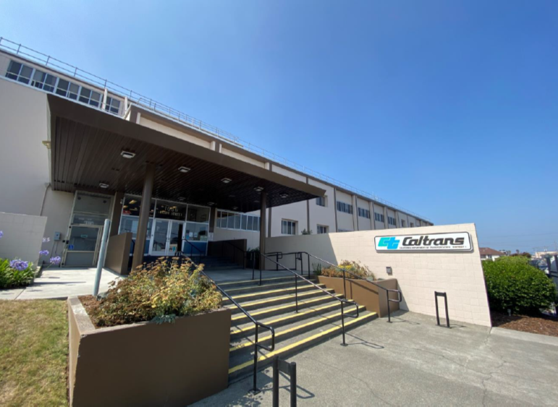
Agenda
Background
  CA Sustainability Requirements
Path to Sustainability
Case Study
Challenges and Results
Keys to Success
Q/A
Office of Sustainability
Notes:
[VM]

Slide 3

State Sustainability Requirements
Executive Orders (EOs):
  EO B-18-12 - Sustainability
  EO B-16-12 – ZEVs
  EO B-30-15 – Climate Adapt
Recent Bills:
  SB 1020 (Laird) – Clean Energy
  SB 1203 (Becker) – Net Zero
  SB 416 (Laird) – LEED Gold
State Administrative Manual (SAM):
  Chapter 1800 – Energy & Sustainability
>30 EOs, statutes, and management memos w/sustainability requirements!
  California Sustainable Policy and Best Practices Manual
DGS led Sustainable Building Working Group to help guide state effort
3
Notes:
[CB]
Executive Order B-18-12- Executive Order B-18-12 is a 2012 California directive issued by Governor Jerry Brown that mandates state agencies to reduce environmental impacts, energy use, and greenhouse gas emissions in state buildings. ZNE for new buildings and major renovations designed after 2025 and for 50% existing ZNE by 2025. LEED silver
EO B-16-12 – target 80% reduction in GHG emissions from transportation 1990 by 2050. goal 1.5 ZEVs on roads by 2025. at least 10% of all new purchased ZEVs and 25% light. OFAM increased targeting 50% non-public by 2025.
EO B-30-15 -Reduce GHG to 40% below 1990 levels by 2030.
SB 1020 – on top of state’s existing requirement of 60% renewable elec by 2030, it sets new benchmark of 90% clean energy by 2025 and 95% clean by 2040
SB 416 – LEED gold new and major over 10k

Slide 4



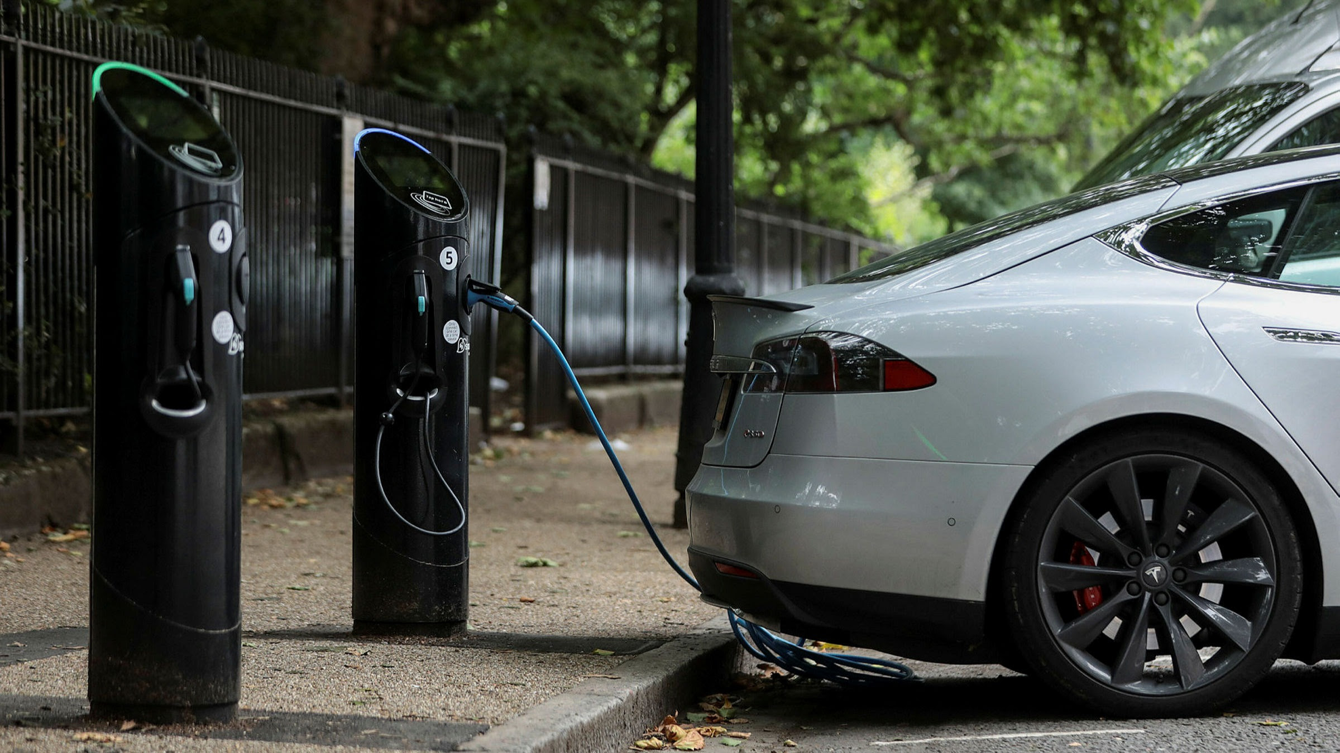
Path to Sustainable Operations
Energy Efficient Equipment
Lighting and HVAC
Renewable Energy
Solar PV
Optimized Controls
BAS, Automatic Demand Response
Electric Vehicles
Chargers
Office of Sustainability
4
This Photo by Unknown Author is licensed under CC BY
Notes:
[VM]

Slide 5

Need for Sustainability
Resolve significant occupant comfort issues
Energy efficiency improvements
  Lighting and HVAC upgrades
Building Management System upgrades
Leverage comprehensive solutions for
  performance improvements
  utility savings
  incentives/rebates
Address deferred maintenance items
Office of Sustainability
5
Notes:
[VM]

Slide 6
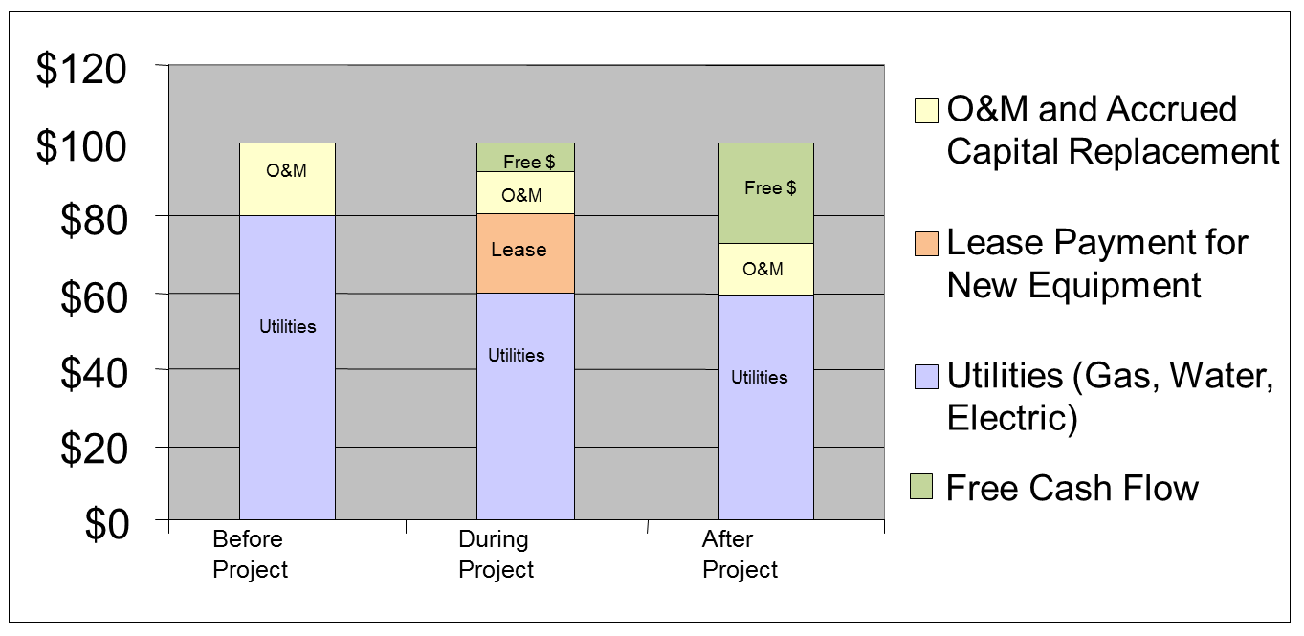
Energy Savings Performance Contracting
Contracting and financing method
Provides upfront financing for energy efficiency projects
Repaid by the guaranteed savings from the upgrades on utility bills
The resulting project creates positive cash flow for your facility
Office of Sustainability
6
Notes:
[VM]
Combined capital and maintenance dollars. Budget stretcher.

Slide 7
ESPC Project Life Cycle
Preliminary Audit to identify potential opportunities
ESCO Project solicited through DGS
Contract awarded to ESCO
Investment Grade Audit (IGA) conducted by ESCO
Implementation of approved IGA by ESCO
Measurement and Verification and performance guarantee
Office of Sustainability
7
Notes:
[VM]

Slide 8
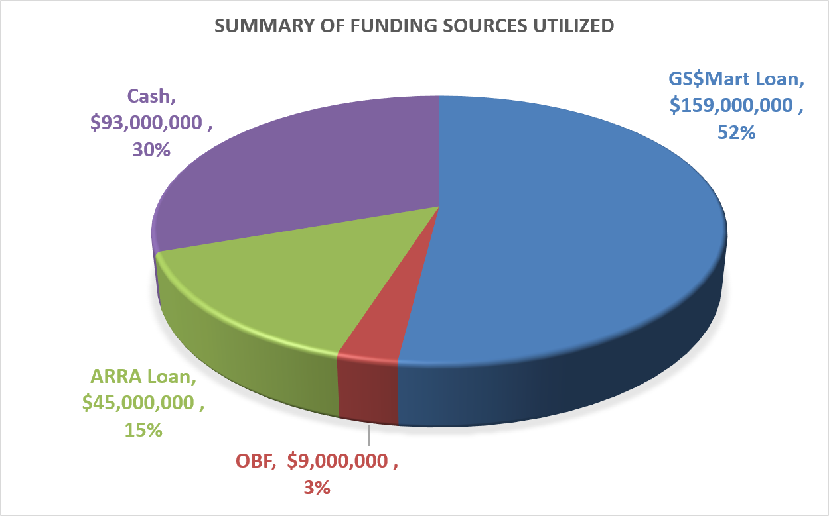
ESPC Funding Options
No or minimal upfront capital expenditure for state client agencies. Loan payments are offset by the utility savings.
Variety of funding options available:
GS$Mart low interest loans
DGS managed ARRA loan fund
Utility On-Bill financing (0% interest)
Agency Cash contribution
Rebates and Incentives *
Office of Sustainability
8
Notes:
[VM]
What are the requirements for each type?
Any limitation for OBF?

Slide 9

Climate Action at Caltrans
Climate Action is one of the five core goals in Caltrans Strategic Plan.
Strategies supporting this goal include:
Decarbonizing fleet, equipment and facilities
Promoting low carbon/zero emission options in project development and construction
Proactively collaborating with external partners to lead on climate action
Office of Sustainability
9
Notes:
[DL]
I am going to show you a success story of how the ESPC process was utilized to develop a comprehensive project at one of our Caltrans locations, but first I want to share about Climate Action at Caltrans.
Caltrans has made Climate Action one of the five core goals in its Strategic Management Plan. To achieve the goal of climate action within the plan, Caltrans has identified several strategies that include decarbonizing fleet, equipment and facilities, promoting low carbon and zero emissions options in project development and construction, and proactively collaborating with external partners to lead on climate action.
These supporting strategies were specifically created in alignment with specific legislative requirements in California, particularly Senate Bill 1203, which requires state agencies to meet net-zero greenhouse gases by 2035 and has influenced scope changes to several projects at Caltrans and is being integrated into the way new facilities will be built in the future.
Caltrans has approximately 8 million square feet of buildings in its portfolio, with approximately 14% of the built environment currently going through ESPC projects. These projects range from district office buildings to equipment repair facilities and transportation management centers.

Slide 10
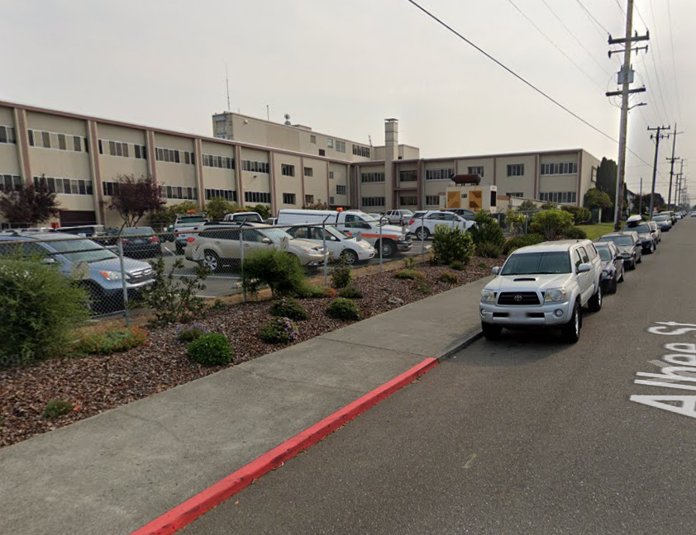
Case Study : Caltrans District 1
Building Concerns:
Energy Usage Intensity (EUI) 59.9.
No mechanical cooling + warming temperatures
High electricity and gas consumption an office building
~50% of energy usage is from gas heating.
Insufficient air flow & poor indoor air quality (IAQ).
Occupant discomfort from single-pane metal frame windows and uninsulated concrete walls.
Office of Sustainability
10
Notes:
[DL]
This project started with a remote energy audit through the State of California Energy Strategy and Support Program, an energy efficiency program offered by investor-owned utilities and administered by Franklin Energy. The remote audit identified potential savings through simple, low-cost measures that could reduce electricity usage by up to 30%.
To validate the savings, Franklin Energy’s engineers made a trip to Eureka to do an on-site audit and qualify the potential measures and help Caltrans get leadership support to pursue the project. The onsite audit found opportunity to reduce natural gas consumption by 40% while also shaving peak demand by 11.7% and reducing overall electricity use by about 9%. The savings opportunities were presented to Caltrans leadership and the project was approved to move forward.
Caltrans partnered with the DGS OS Energy Savings Program conduct an investment grade audit that could be implemented as a turn-key project with fixed-firm pricing. The IGA would validate savings potential and open the door to financing options that could use energy savings to help pay for the project if it was needed.

Slide 11
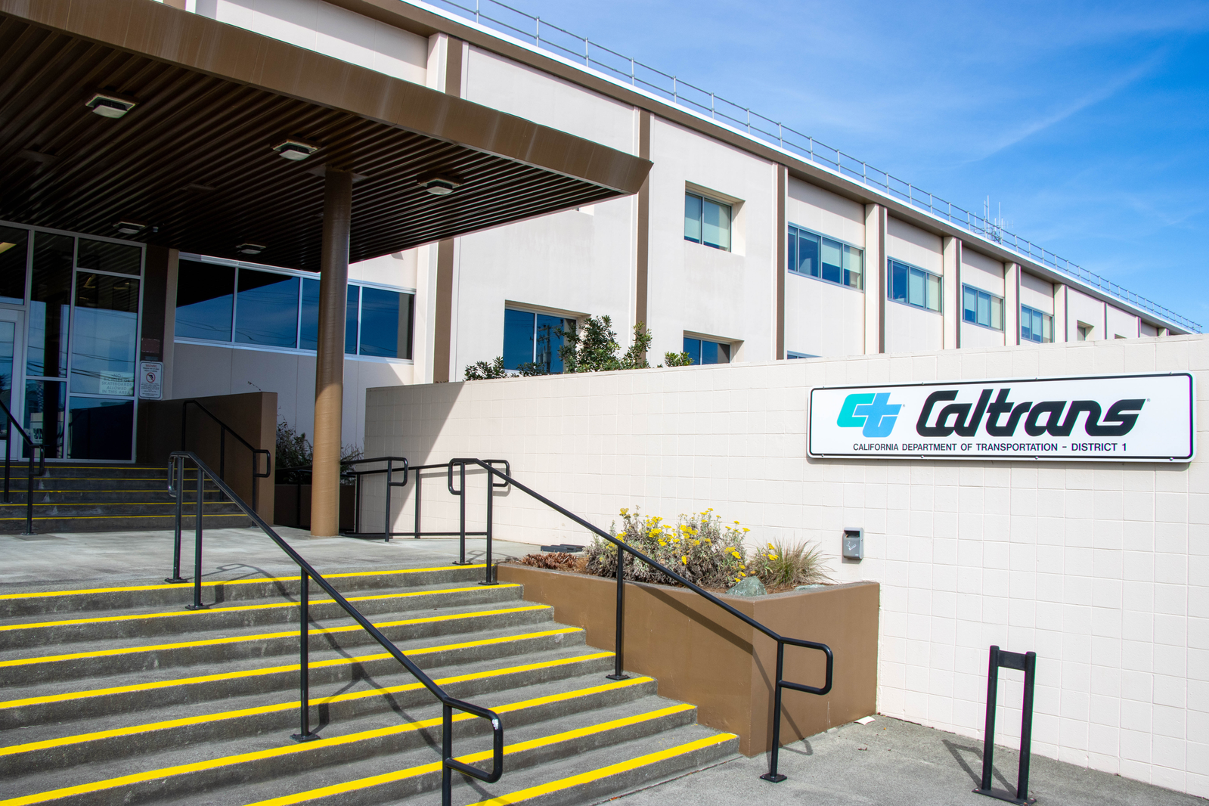
Application of Holistic Approach
  Need for Mechanical Cooling
  Occupant Comfort
  State Requirements
  Automated Demand Response
  EV Charging Needs
Office of Sustainability
11
Notes:
[CB] During the IGA discovery phase, the project team worked with the facility to understand the building needs and projects that were planned for the facility. It was discovered that the facility was planning on adding cooling to the facility for the fist time in the buildings 70-year history. There was also recently signed legislation, Senate Bill 1203, that requires state agencies to achieve net-zero GHG by 2035.
In addition to the mechanical needs, the state was being called on to support the states electrical grid during peak energy events by participating in demand response programs and automating wherever possible, a requirement from Governor Brown’s Executive Order B-18-12. Peak events in September of 2022 created a new focus on these demand response efforts.
There was also a separate project planned to install additional EV chargers at the facility, which needed to be considered in the overall electrical design to support the addition of mechanical cooling.

Slide 12
Advantages to a Holistic Approach
Efficiency First Focus
Cost Effectiveness
Flexible
Considers Multiple Needs
Collaborative
Office of Sustainability
12
Notes:
[DL]
The Design-Build nature of ESPC gave us the ability to consider a holistic approach in developing the scope. Rather than a pre-defined scope, we were able to consider all the needs of the facility and try to implement a comprehensive scope that addressed occupant comfort, deferred maintenance, legislative requirements, efficiency requirements, and the impact of energy conservation measures on other existing systems of the building.
For example, the building had historically cooled the building by opening the windows to let in the breeze, but this old habit would work against the mechanical cooling, so updated windows were considered for the scope.
Another example is the need for cooling combined with legislative requirements to eliminate GHG from operations allowed us to combine scope and achieve two goals with one measure.
The ability to combine scope and consider the full picture allowed us to prevent the need for future projects by right sizing the electrical systems through this project to account for the increased load from cooling and EVSE, resulting in saved soft costs by doing one comprehensive project instead of several smaller scopes.

Slide 13
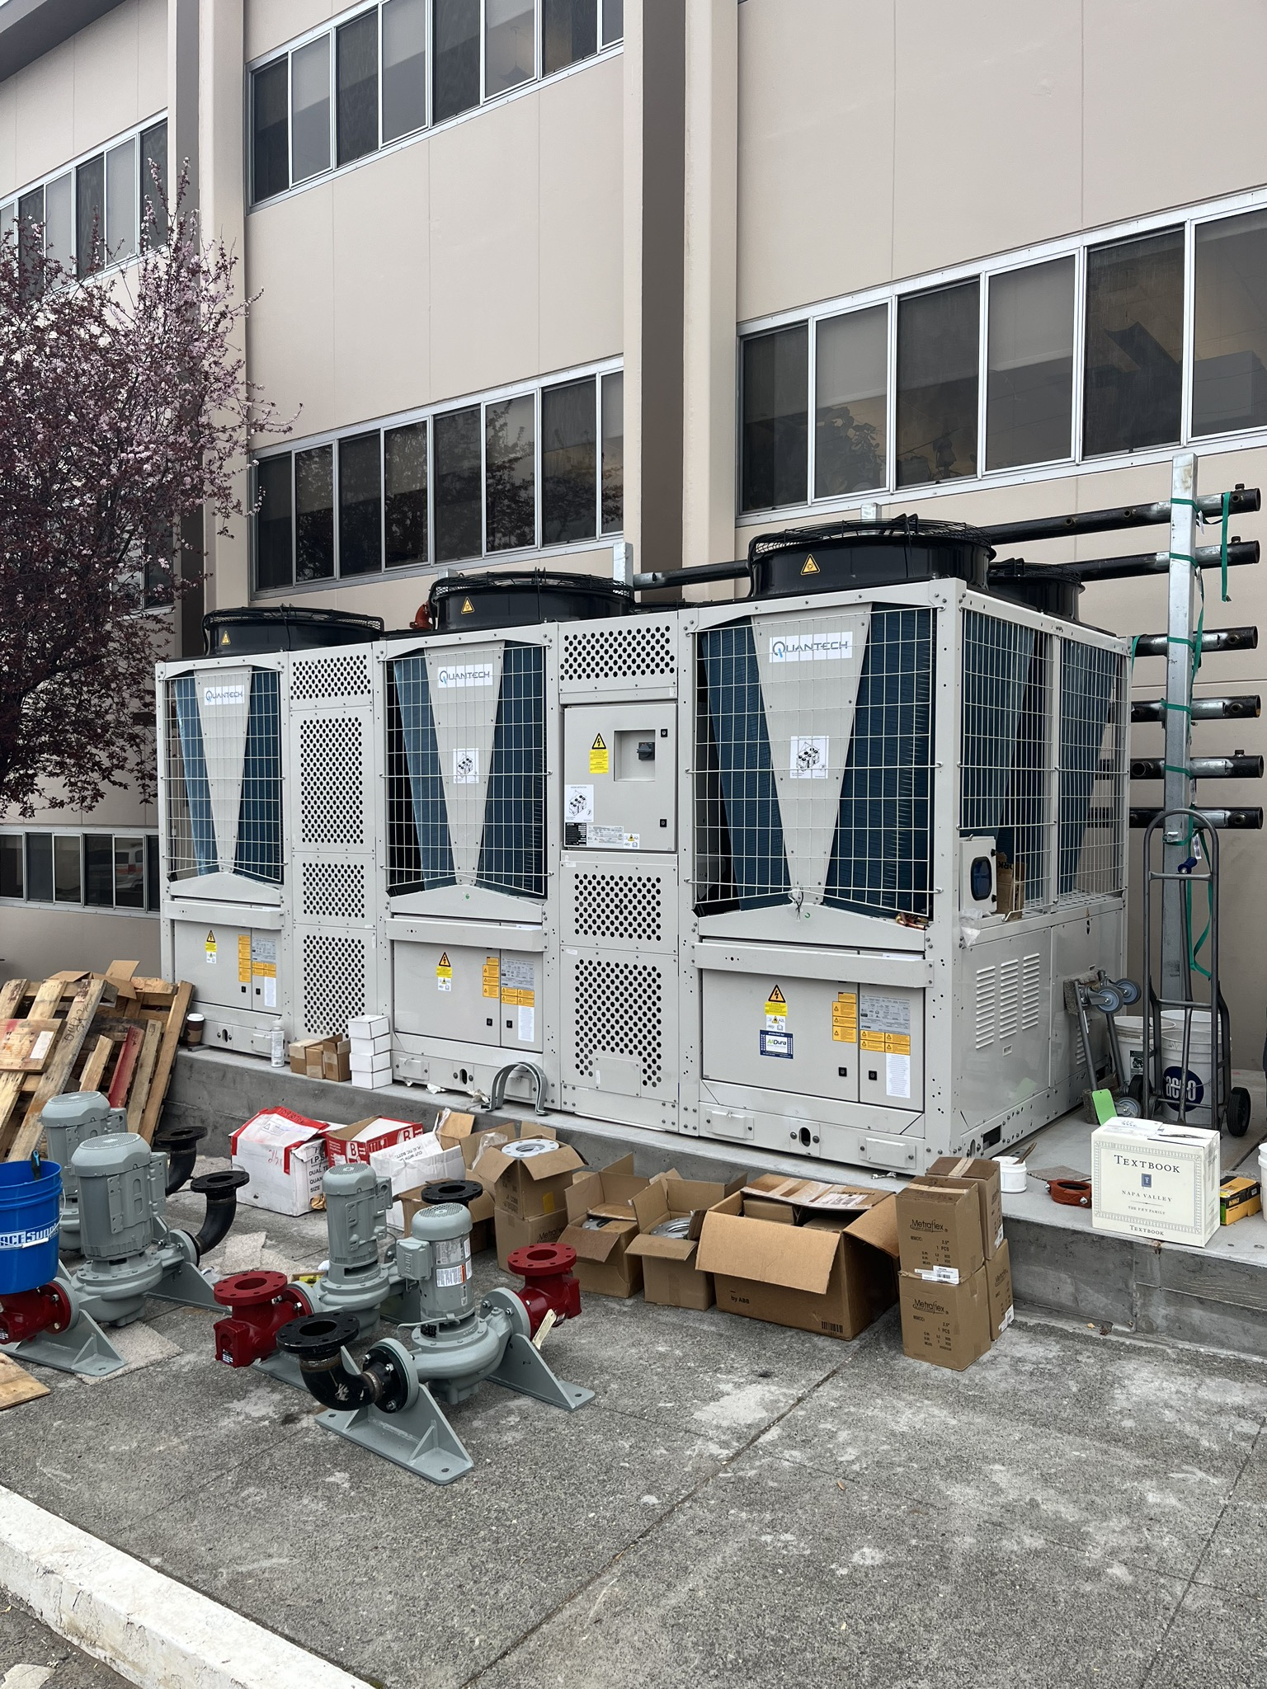
Energy Conservation Measures
4-pipe air-to-water heat pump
Heat pump water heater & 300-gal expansion tank
New VAV terminals with reheat coils
Dual-purpose heating/cooling coils in Air Handler Units
Building Automation System Updates
Energy Efficient Window Upgrades
Electrical Upgrades
LED Lighting Upgrades
13
Notes:
[CB]
NEW :Retrofitted the existing heating only coils in the AHU units with dual-purpose (heating & cooling) coils served by a new heat pump system, replacing existing constant volume reheat coils with new VAV terminal units with reheat coils. The new heat pump system consists of air-to-air and air-to-water heat pumps to provide heating and cooling simultaneously.
Installed a new independent water-to-water heat pump system to serve the domestic hot water loop and removing the loop from the heating hot water loop to reduce unnecessary natural gas usage during the summertime when heating in the building is not needed. Existing gas-fired boilers will remain in place and connected to the heating loop to provide back-up heating during power outages.
NEW BAS: The existing BAS system was upgraded to support the new AWHP system, terminal units with HW reheat coils and distribution pumps. Implement a standby mode using new lighting occupancy sensors. space temperature setpoints were adjusted and ventilation rates set to minimum flow to reduce energy heating, cooling, and fan energy consumption. Demand response controls!
BAS system Retrocommissioned to ensure sequence of operations and setpoints are optimized.
NEW windows: Replaced all windows and storefront entrances with fixed, double-pane, low-e, thermally insulated glazing systems. The new glazing system will not only improve building occupants’ comfort but will also reduce energy consumption at District 1.
NEW electrical -existing 208-volt main switchboard was over 60 years old and nearing the end of its useful life.
Installed a new 480-Volt main electric service to support all existing building loads, all new HVAC equipment, EV charging stations, and capacity for future loads.
New lighting: retrofitted existing lighting fixtures with new Type C LED fixtures. provided a consistent lighting look throughout the building while reducing energy consumption. Additional O&M savings will be generated by removing the existing old electronic ballasts.
Title 24 compliant lighting controls will be installed to reduce energy consumption, as well as extend the useful life of lamps and fixtures. dimming capabilities if future dimming controls are desired and ADR compliance

Slide 14
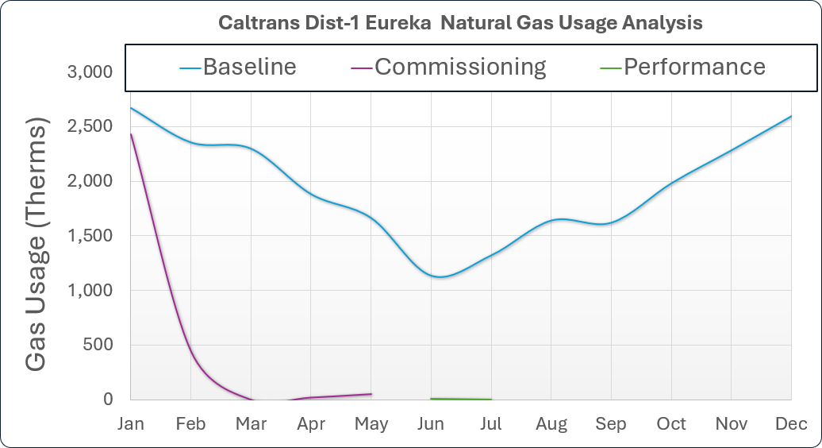
Project Outcomes -Energy
  48.5% site EUI reduction(59.9 > 30.8)
  51,557 kWh Savings
  100% NG reduction (23,462 therms)
  Utility cost savings of $74,606/yr
  Raised Energy Star Score (77 to 90)
Office of Sustainability
14
Notes:
[CB}
chart with the latest natural gas consumption compared to the baseline at Caltrans D1. demonstrates tuning process that Cx agent and team was dealing with at the start of the year. As the new heat pump stabilized and reliability improved, we were able to shift away from the gas boiler more consistently after February. We don’t have a lot of performance data yet, but this does show pretty clear progress on the natural gas side at least.
Increase its Energy Star score to the top 10% in the United States.

Slide 15
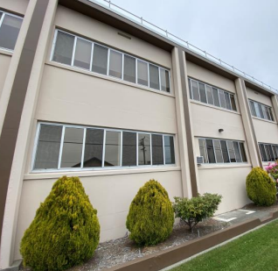
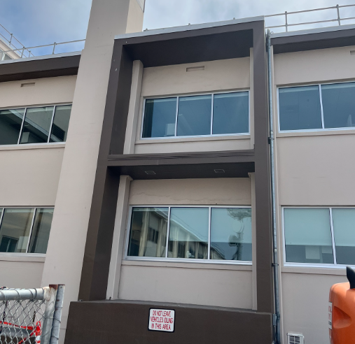
Before & After - Windows
15
Notes:
[DL]

Slide 16
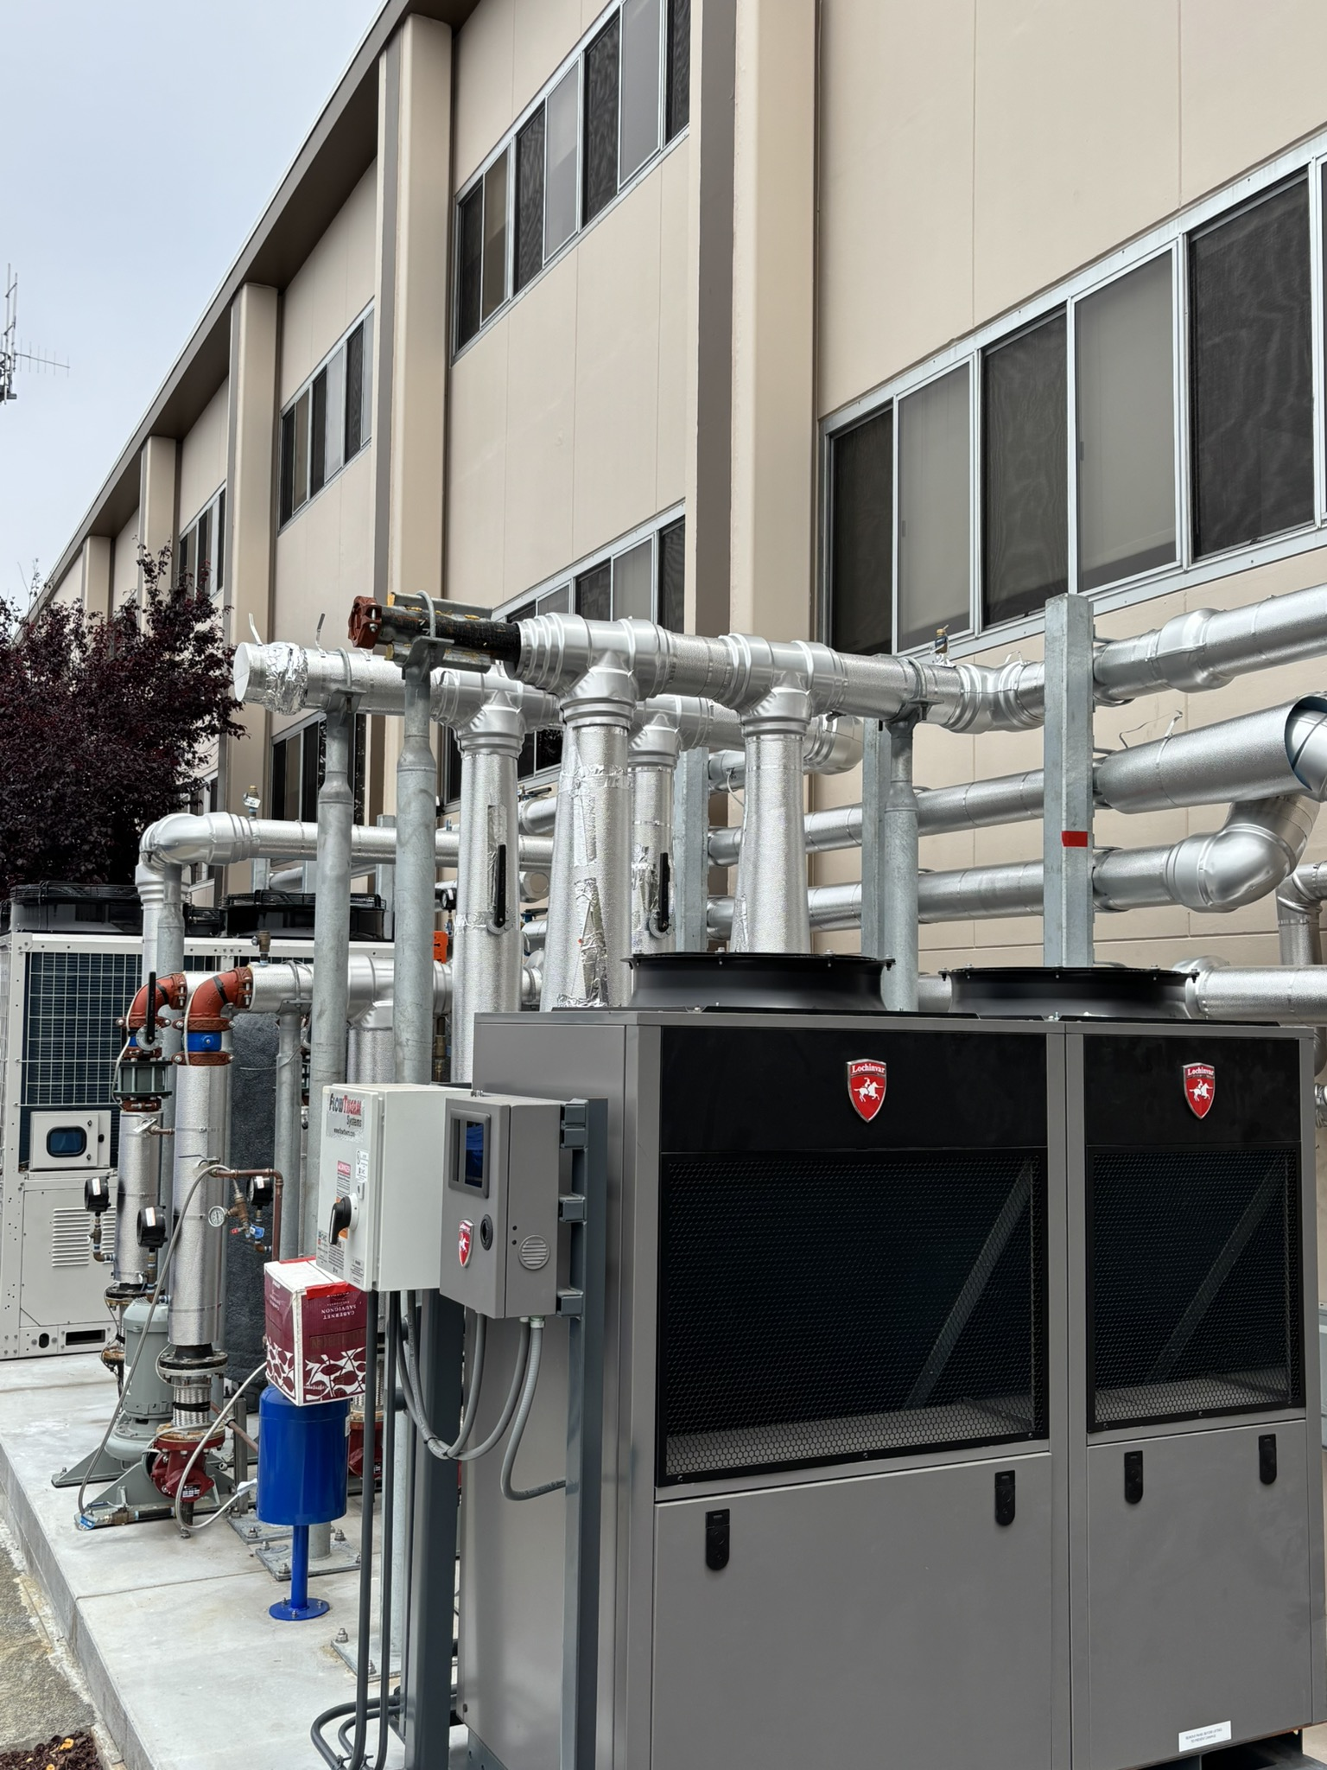
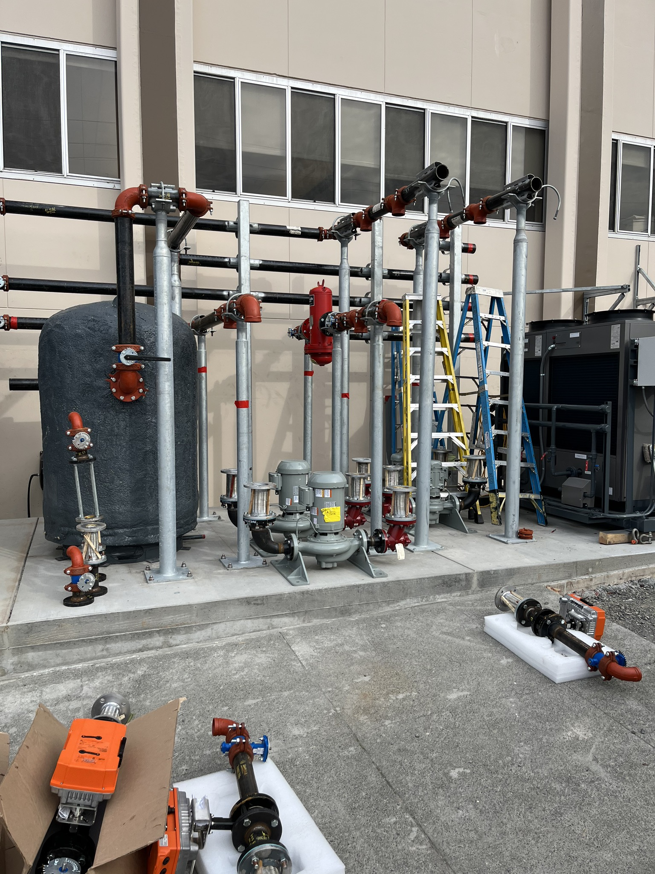
New Mechanical
16
Notes:
[DL]

Slide 17
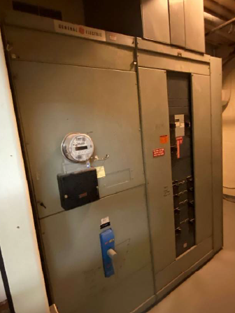
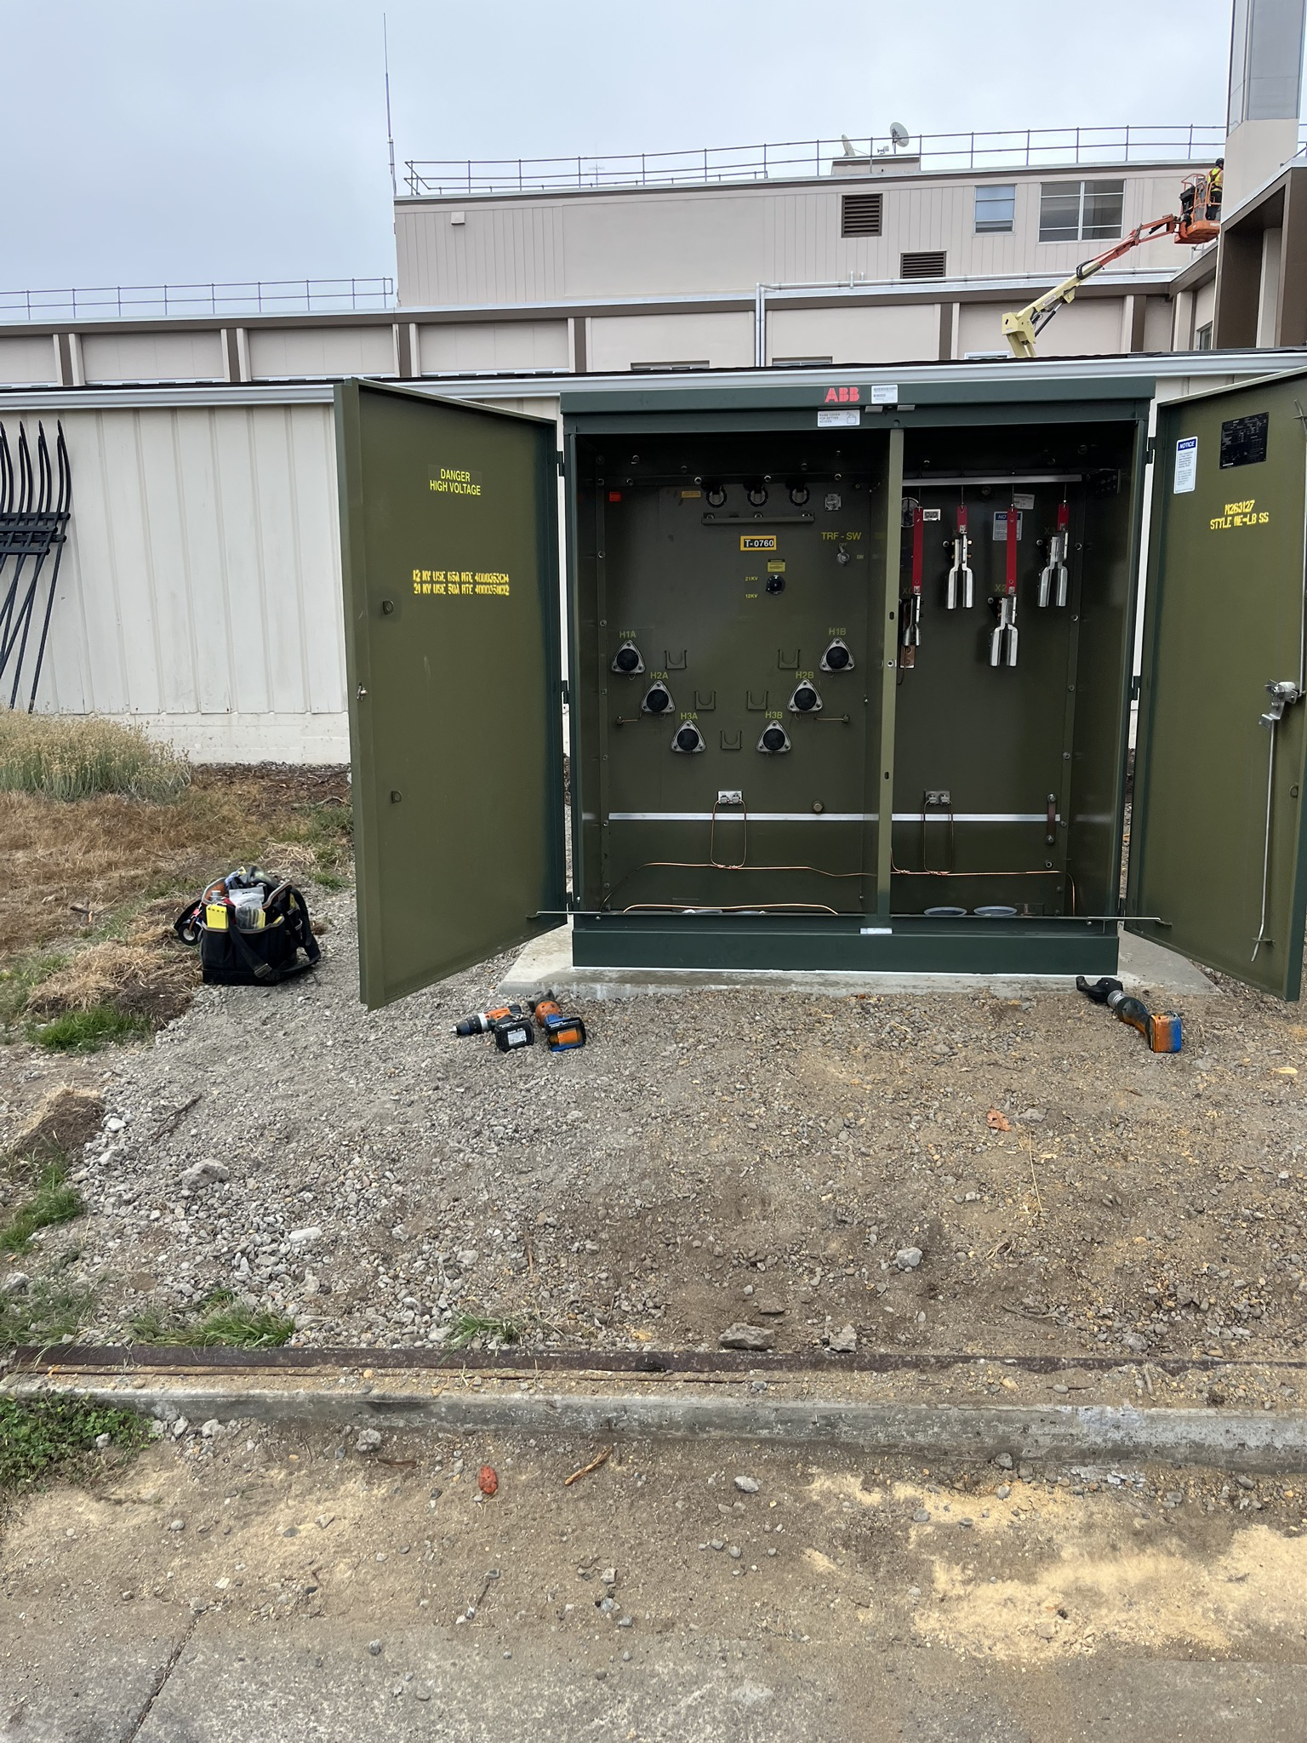
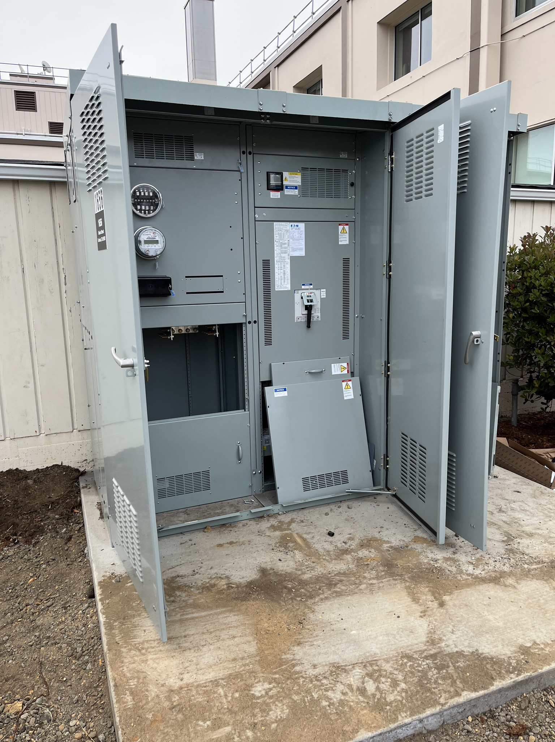
Before & After – Electrical
17
Notes:
[CB]
Existing electrical
left existing electrical service is a 1,200 amp/208-volt, 3-phase service..
Proposed electrical
Install a new 480-Volt main electric service to support all existing building loads, all new HVAC equipment, 125 kVA for EV charging stations, and 50 kVA capacity for future loads.
Lighting- placing or retrofitting existing lighting fixtures with new Type C LED fixtures. This measure will provide a consistent lighting look throughout the building while reducing energy consumption. Additional O&M savings will be generated by removing the existing old electronic ballasts.
Additionally, Title 24 compliant lighting controls will be installed to reduce energy consumption, as well as extend the useful life of lamps and fixtures. Type C LED drivers have full 0-10V dimming capabilities if future dimming controls are desired.
Controls- upgraded to support the new AWHP system, terminal units with HW reheat coils and distribution pumps. Implement a standby mode using new lighting occupancy sensors. During standby, space temperature setpoints will be adjusted up or down by 1 °F and ventilation rates will be set to minimum flow to reduce energy heating, cooling, and fan energy consumption.
Additionally, the BAS system will be retro-commissioned to ensure sequence of operations and setpoints are optimized.

Slide 18

Project Outcomes – Other Benefits
  O+M Savings of $15,500 annually
  Addition of Mechanical Cooling
  89 % reduced CO2
  Automated Demand Response Ready
  Targeting LEED recertification
  Zero Net Carbon opportunity
  Increased Occupant Comfort
  MBCX
Office of Sustainability
18
Notes:
[DL]

Slide 19
Incentives
$12k – 179D Federal Energy Efficiency Tax Credit
$76k – California energy design assistance credit
Office of Sustainability
19
Notes:
[CB}
energy models for major reno. Funded by IOUs. Replaced savings by design program

Slide 20
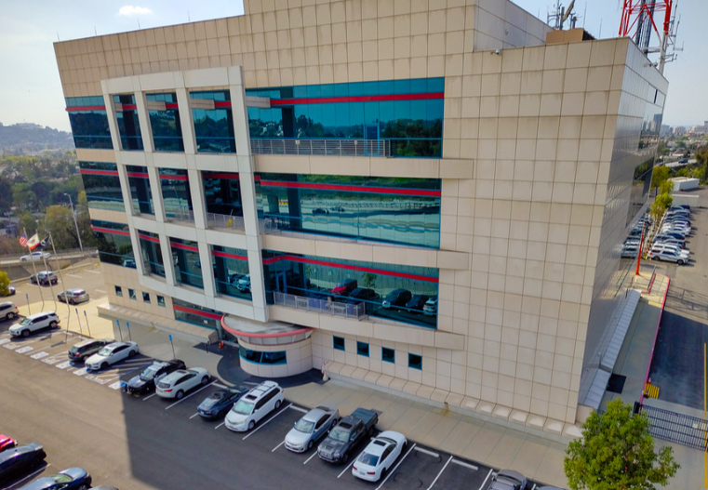
DGS ESP - Additional Caltrans Projects
Proposed Deep Retrofit & Electrification:
Domestic HW Upgrades – Heat pump water heater
BMS upgrades, RCx & Air Distribution
HVAC Upgrade- Electrify via heat pump technology and replace existing heating hot water coils in air-handling units with dual purpose (heating/cooling) coils.
Electrical System Upgrades
Monitoring Based Commissioning (MBCx) and LEED
Renewables
Office of Sustainability
Notes:
[DL]
Caltrans has approximately 8 million square feet within its portfolio, with approximately 14% of the built environment going through ESPC projects.
HVAC Upgrade- Install air-to-water heat pump (A2WHP) system and replace existing heating hot water coils in air-handling units with dual purpose (heating/cooling) coils.
Monitoring Based Commissioning (MBCx)
Electrify via heat pump technology
Install air-to-water heat pump (A2WHP) system

Slide 21
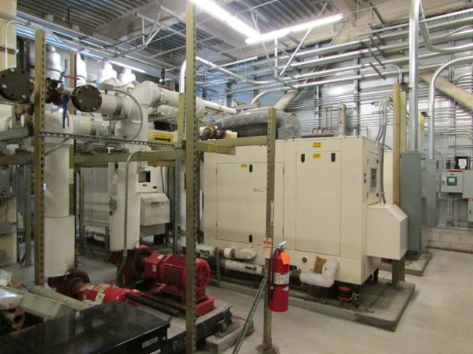
Other ESPC Projects
Caltrans Districts 4, 7, 8, 11
Franchise Tax Board
Department of Justice (8 Labs)
CalFire (5 sites)
Secretary of State Building
Department of Water Resources
Office of Sustainability
21
Notes:
[VM}
ECM 1 Interior/ Exterior LED Lighting and Controls ECM @ HVAC Unit Upgrades ECM 3 Water Efficient Plumbing Fixture Installation ECM4 Solar Photovoltaics Installation ECM55 Building Management System IUpgrades ECM 6 Solar PV O&M ECM 7 Performance Assurance

Slide 22
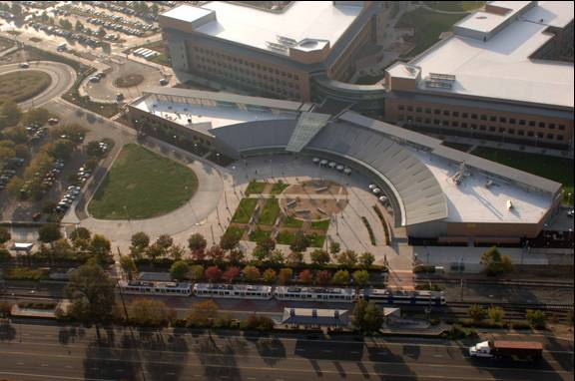
Other DGS projects (FTB)
Large Scale
  1.9 mil sqft
  Mission critical
  $25 million (Loan funded)
Comprehensive
  Demand reduction > 1 MW!
  Energy reduction > 10 million kWh
  Code compliance
  Deferred Maintenance items
Office of Sustainability
22
Notes:
[VM]

Slide 23
Keys To Success
  Marketing program for seasonal energy savings education
  Planning shutdowns early
  Engage all stakeholders -show them the value of ESPC
  Electrification and energy efficiency first, followed by renewables
  Early DSA involvement/ADA compliance
  Lighting mockups - larger sampling
  ADR implementation
  Monitoring Based Commissioning (MBCx)
  Other user impacts e.g. Low-E Glass impact on cell signal
Office of Sustainability
23
Notes:
[CB]
Economies of scale can lead to significant project savings vs. smaller projects with minimal scope
Educate engineers and tenants on set points
Understand deferred maintenance needs and planned projects
The impact of Low-E glass on cellular signals was not something considered at the onset of the project. The metallic coating used to thermally insulate windows can also block the radio frequency used for cell phones. This coating, combined with the concrete structure of the building impacted occupant's cellular signal. The fix is to incorporate distributed antenna systems into the building.

Slide 24

Questions?
Office of Sustainability
24

